Slide 1


Full text search & JSON
<Practice with full text search & JSON>

Slide 2


The task has been prepared by Yevhen Yermolenko

Slide 3
Full Text Search
<Let’s explore PostgreSQL Full Text Search>

Slide 4
Full-Text Search
SELECT col FROM table WHERE col LIKE ‘%some_value%’;

Slide 5
Full-Text Search
WASTED
SELECT col FROM table WHERE col LIKE ‘%some_value%’;
Operators ~, ~*, LIKE, ILIKE don’t work well for full-text search

Slide 6
Full-Text Search
WASTED
SELECT col FROM table WHERE col LIKE ‘%some_value%’;
Operators ~, ~*, LIKE, ILIKE don’t work well for full-text search
- No linguistic support (satisfies != satisfy);

Slide 7
Full-Text Search
WASTED
SELECT col FROM table WHERE col LIKE ‘%some_value%’;
Operators ~, ~*, LIKE, ILIKE don’t work well for full-text search
No linguistic support (satisfies != satisfy);
No ordering provided for large search result;

Slide 8
Full-Text Search
WASTED
SELECT col FROM table WHERE col LIKE ‘%some_value%’;
Operators ~, ~*, LIKE, ILIKE don’t work well for full-text search
No linguistic support (satisfies != satisfy);
No ordering provided for large search result;
No index support -> slow search

Slide 9
Full-Text Search

Slide 10
Full-Text Search
Core Concepts:
Document – the context you want to search through.

Slide 11
Full-Text Search
Core Concepts:
Document – the context you want to search through.
Tokens – raw fragments of parsed document.

Slide 12
Full-Text Search
Core Concepts:
Document – the context you want to search through.
Tokens – raw fragments of parsed document.
Lexemes – normalized token (Days -> day).

Slide 13
Full-Text Search
Core Concepts:
Document – the context you want to search through.
Tokens – raw fragments of parsed document.
Lexemes – normalized token (Days -> day).
Dictionaries – collection of lexemes.

Slide 14
Full-Text Search
Data Types:
TSVECTOR
TSQUERY

Slide 15
Full-Text Search
Data Types:
TSVECTOR
TSQUERY
representation of a document optimized for searching

Slide 16
Full-Text Search
Data Types:
TSVECTOR
TSQUERY
representation of a document optimized for searching
representation of a search query

Slide 17
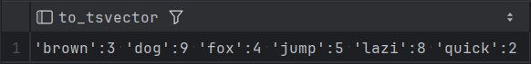
Full-Text Search
Data Types:
TSVECTOR
TSQUERY
representation of a document optimized for searching
representation of a search query
SELECT to_tsvector('The quick brown fox jumps over the lazy dog.');

Slide 18
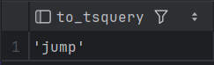
Full-Text Search
Data Types:
TSVECTOR
TSQUERY
representation of a document optimized for searching
representation of a search query
SELECT to_tsvector('The quick brown fox jumps over the lazy dog.');
SELECT to_tsquery('jumping');

Slide 19
Full-Text Search
Data Types:
TSVECTOR
TSQUERY
representation of a document optimized for searching
representation of a search query
SELECT to_tsvector('The quick brown fox jumps over the lazy dog.');
SELECT to_tsquery('jumping');
SELECT to_tsvector(‘jumps’),
to_tsvector(‘jumped’),
to_tsvector(‘jumping’),

Slide 20
Full-Text Search
Data Types:
TSVECTOR
TSQUERY
representation of a document optimized for searching
representation of a search query
SELECT to_tsvector('The quick brown fox jumps over the lazy dog.');
SELECT to_tsquery('jumping');
SELECT to_tsvector(‘jumps’),
to_tsvector(‘jumped’),
to_tsvector(‘jumping’),

Slide 21
Full-Text Search
Data Types:
TSVECTOR
TSQUERY
representation of a document optimized for searching
representation of a search query
SELECT to_tsvector('The quick brown fox jumps over the lazy dog.');
SELECT to_tsquery('jumping');
SELECT to_tsvector(‘jumps’),
to_tsvector(‘jumped’),
to_tsvector(‘jumping’),
Include Boolean, negation, group operators & | ! – ()

Slide 22
Full-Text Search
Data Types:
TSVECTOR
TSQUERY
representation of a document optimized for searching
representation of a search query
SELECT to_tsvector('The quick brown fox jumps over the lazy dog.');
SELECT to_tsquery('jumping');
SELECT to_tsvector(‘jumps’),
to_tsvector(‘jumped’),
to_tsvector(‘jumping’),
Include Boolean, negation, group operators & | ! – ()
plainto_tsquery transforms the unformatted text to a tsquery value. It doesn’t recognize operators & | ! – ()

Slide 23
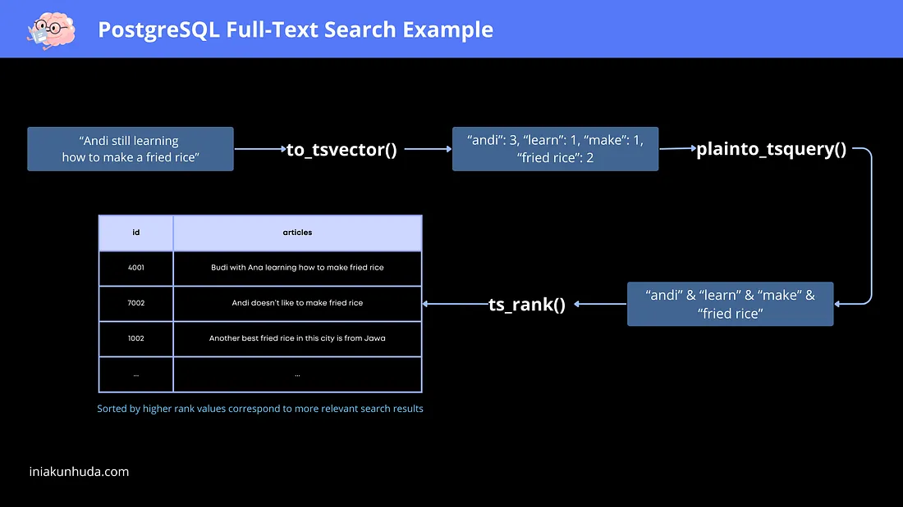
Full-Text Search

Slide 24
Full-Text Search
Operators
@@

Slide 25
Full-Text Search
Operators
@@ - evaluates the similarity between the text in a document and query

Slide 26
Full-Text Search
Operators
@@ - evaluates the similarity between the text in a document and query
tsvector @@ tsquery -> true/false

Slide 27
Full-Text Search
Operators
@@ - evaluates the similarity between the text in a document and query
tsvector @@ tsquery -> true/false
SELECT to_tsvector('The quick brown fox jumps over the lazy dog.’)
@@ to_tsquery(‘jumping’) result;

Slide 28

Full-Text Search
Operators
@@ - evaluates the similarity between the text in a document and query
tsvector @@ tsquery -> true/false
SELECT to_tsvector('The quick brown fox jumps over the lazy dog.’)
@@ to_tsquery(‘jumping’) result;

Slide 29
Full-Text Search

Slide 30
Full-Text Search
Examples
CREATE TABLE posts(
id SERIAL PRIMARY KEY,
title TEXT NOT NULL,
body TEXT,
body_search TSVECTOR
GENERATED ALWAYS AS (to_tsvector('english',body)) STORED
);

Slide 31
Full-Text Search
Examples
CREATE TABLE posts(
id SERIAL PRIMARY KEY,
title TEXT NOT NULL,
body TEXT,
body_search TSVECTOR
GENERATED ALWAYS AS (to_tsvector('english',body)) STORED
);
INSERT INTO posts(title, body)
VALUES
('Introduction to PostgreSQL', 'This is an introductory post about PostgreSQL...'),
('Advanced PostgresSQL Techniques', 'In this post, we delve into advanced…'),
('PostgreSQL Optimization Strategies', 'This post explores various...');

Slide 32
Full-Text Search
Examples
CREATE TABLE posts(
id SERIAL PRIMARY KEY,
title TEXT NOT NULL,
body TEXT,
body_search TSVECTOR
GENERATED ALWAYS AS (to_tsvector('english',body)) STORED
);
INSERT INTO posts(title, body)
VALUES
('Introduction to PostgreSQL', 'This is an introductory post about PostgreSQL...'),
('Advanced PostgresSQL Techniques', 'In this post, we delve into advanced…'),
('PostgreSQL Optimization Strategies', 'This post explores various...');
SELECT id, body_search FROM posts;

Slide 33
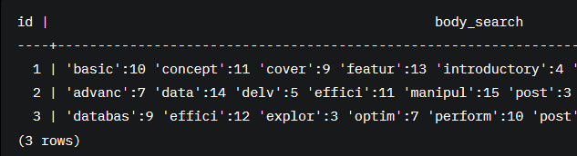
Full-Text Search
Examples
CREATE TABLE posts(
id SERIAL PRIMARY KEY,
title TEXT NOT NULL,
body TEXT,
body_search TSVECTOR
GENERATED ALWAYS AS (to_tsvector('english',body)) STORED
);
INSERT INTO posts(title, body)
VALUES
('Introduction to PostgreSQL', 'This is an introductory post about PostgreSQL...'),
('Advanced PostgresSQL Techniques', 'In this post, we delve into advanced…'),
('PostgreSQL Optimization Strategies', 'This post explores various...');
SELECT id, body_search FROM posts;

Slide 34
Full-Text Search
Examples
SELECT id, body
FROM posts
WHERE body_search @@ to_tsquery(‘PostgreSQL’);

Slide 35
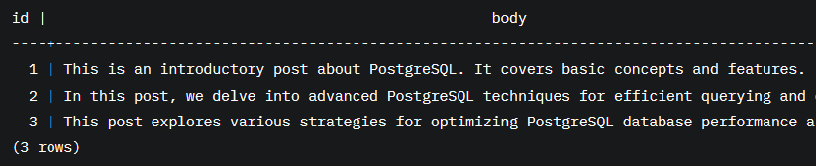
Full-Text Search
Examples
SELECT id, body
FROM posts
WHERE body_search @@ to_tsquery(‘PostgreSQL’);

Slide 36
Full-Text Search
Examples
CREATE INDEX pgweb_idx ON pgweb USING GIN (to_tsvector('english', body));

Slide 37
Full-Text Search
Examples
CREATE INDEX pgweb_idx ON pgweb USING GIN (to_tsvector('english', body));
WHERE to_tsvector('english', body) @@ 'a & b'

Slide 38
Full-Text Search
Examples
CREATE INDEX pgweb_idx ON pgweb USING GIN (to_tsvector('english', body));
WHERE to_tsvector('english', body) @@ 'a & b'
WHERE to_tsvector(body) @@ 'a & b'

Slide 39
Full-Text Search
Examples
CREATE INDEX pgweb_idx ON pgweb USING GIN (to_tsvector('english', body));
WHERE to_tsvector('english', body) @@ 'a & b'
WHERE to_tsvector(body) @@ 'a & b'

Slide 40
Full-Text Search

Slide 41
Full-Text Search
Limitations
The length of each lexeme must be less than 2 kilobytes

Slide 42
Full-Text Search
Limitations
The length of each lexeme must be less than 2 kilobytes
The of a tsvector (lexemes + positions) must be less than 1 megabyte

Slide 43
Full-Text Search
Limitations
The length of each lexeme must be less than 2 kilobytes
The of a tsvector (lexemes + positions) must be less than 1 megabyte
The number of lexemes must be less than 2⁶⁴

Slide 44
Full-Text Search
Limitations
The length of each lexeme must be less than 2 kilobytes
The of a tsvector (lexemes + positions) must be less than 1 megabyte
The number of lexemes must be less than 2⁶⁴
No more than 256 positions per lexeme

Slide 45
Full-Text Search

Slide 46
Full-Text Search
ADVANTAGES:
Cost Efficiency – no need for 3rd parties like ElasticSearch

Slide 47
Full-Text Search
ADVANTAGES:
Cost Efficiency – no need for 3rd parties like ElasticSearch
Data Consistency – no need to sync search engine with database engine

Slide 48
Full-Text Search
ADVANTAGES:
Cost Efficiency – no need for 3rd parties like ElasticSearch
Data Consistency – no need to sync search engine with database engine
Native support for multiple languages and custom dictionaries

Slide 49
JSON

Slide 50
JSON
JSON data types are for storing JSON (JavaScript Object Notation) data, as specified in RFC 7159. Such data can also be stored as text, but the JSON data types have the advantage of enforcing that each stored value is valid according to the JSON rules

Slide 51
JSON
JSON data types are for storing JSON (JavaScript Object Notation) data, as specified in RFC 7159. Such data can also be stored as text, but the JSON data types have the advantage of enforcing that each stored value is valid according to the JSON rules
PostgreSQL offers two types for storing JSON data: json and jsonb

Slide 52
JSON
JSON data types are for storing JSON (JavaScript Object Notation) data, as specified in RFC 7159. Such data can also be stored as text, but the JSON data types have the advantage of enforcing that each stored value is valid according to the JSON rules
PostgreSQL offers two types for storing JSON data: json and jsonb >>> jsonpath

Slide 53
JSON
JSON data types are for storing JSON (JavaScript Object Notation) data, as specified in RFC 7159. Such data can also be stored as text, but the JSON data types have the advantage of enforcing that each stored value is valid according to the JSON rules
PostgreSQL offers two types for storing JSON data: json and jsonb >>> jsonpath
stores an exact copy of the input text,
which processing functions
must reparse on each execution

Slide 54
JSON
JSON data types are for storing JSON (JavaScript Object Notation) data, as specified in RFC 7159. Such data can also be stored as text, but the JSON data types have the advantage of enforcing that each stored value is valid according to the JSON rules
PostgreSQL offers two types for storing JSON data: json and jsonb >>> jsonpath
stores an exact copy of the input text,
which processing functions
must reparse on each execution
stored in a decomposed binary format that makes it
slightly slower to input due to added conversion overhead,
but significantly faster to process.
Supports indexing

Slide 55
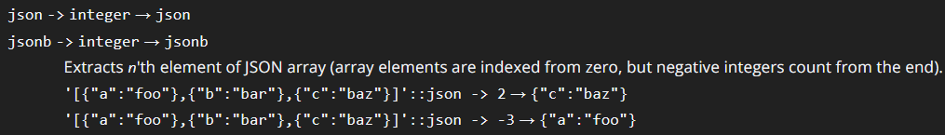
JSON

Slide 56
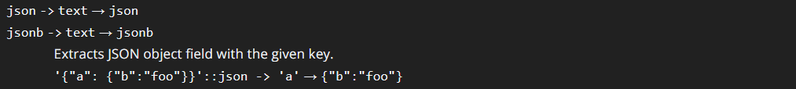
JSON

Slide 57
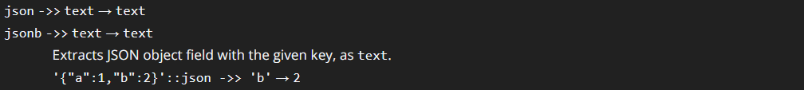
JSON

Slide 58
Full-Text Search & JSON
Resources:
PostgreSQL Full-Text Search: A Powerful Alternative to Elasticsearch for Small to Medium Applications
PostgreSQL Full Text Search
Official documentation for full-text search
Official PostgreSQL documentation for JSON

Slide 59

Thank you
Author: Yevhen Yermolenko
My LinkedIn: https://www.linkedin.com/in/yerm/
May 2025
Join Codeus community in Discord
Join Codeus community in LinkedIn

